Slide 1

N-Bodies Algorithm Sequential and MPI Implementation
Presented by: Francesco Finucci Course: Parallel and Distributed Programming Academic Year: 2024/2025

Slide 2
Table of contents
01
02
03
04
05
06
Introduction and Goals
Algorithm and Data Structures
Sequential Implementation
Performance Evaluation
Conclusions
Parallel implementation with MPI

Slide 3
01
Introduction and Goals

Slide 4
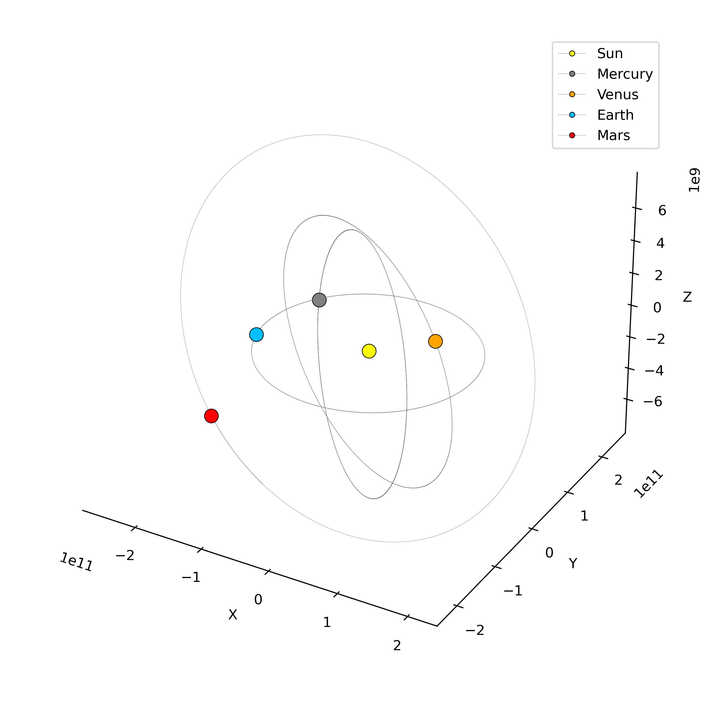
Project Overview
This project implements a parallel solution to the N-body gravitational problem using MPI for physics simulations. The N-body problem consists in simulating the motion of N celestial bodies under mutual gravitational attraction. We simulate N bodies computing gravitational forces using Newton's law and Runge-Kutta integration.

Slide 5

Goals
Evaluate performance with multiple combinations
Process N bodies, compute forces and update positions
Simulate N-body gravitational interaction in the 3D space

Slide 6
Execution Environment
Local Testing
MPI setup
Sibilla Multiprocessor
Initial debugging and validation were done on local machines to ensure correctness
MPI programs were compiled with mpicc and run using mpirun after loading the MPI module.
Final performance tests were executed on a 64-core HPC system via SSH.

Slide 7
02
Algorithm and Data Structures

Slide 8
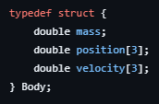
Data structures overview
Why this structure?
Complete State Representation​
Double precision accuracy
Cache efficiency
MPI ready
Facilitates calculations
d(pᵢ, pⱼ) = √[(xᵢ - xⱼ)² + (yᵢ - yⱼ)² + (zᵢ - zⱼ)²] F = G × m₁ × m₂ / (d² + ε) a = F / m₁ = G × m₂ / (d² + ε)
Notes:
Complete State Representation: Each Body contains all information needed for gravitational dynamics under Newton's laws
Double Precision Accuracy: 64-bit floats handle astronomical scales (10¹³ m positions, 10³⁰ kg masses)
Cache Efficiency: Related data (mass, position, velocity) stored together in 56-byte structure
MPI Communication Ready: Custom datatype enables efficient network transmission
Vector Operations: 3D arrays facilitate straightforward distance and force calculations

Slide 9
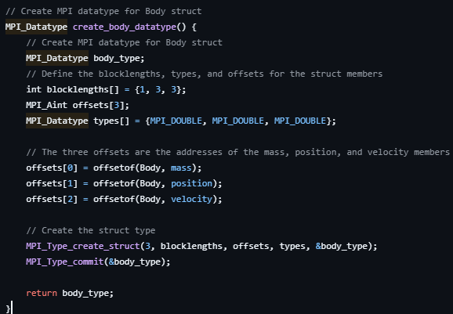
Creating an MPI type using Body
Why this structure?
Reduces network latency overhead
Type safety
Automatic offset calculation
Notes:
Single Network Transaction: Send entire Body struct in one MPI call instead of 7 separate calls
Automatic Padding Handling: offsetof() correctly handles compiler memory alignment
Vectorized Communication: MPI can optimize bulk transfers of multiple structs
Type Safety: MPI knows the exact data layout, preventing corruption
Network Optimization: Enables efficient packing into network packets

Slide 10
03
Sequential implementation

Slide 11
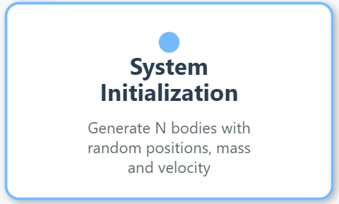
Workflow

Slide 12

Workflow

Slide 13
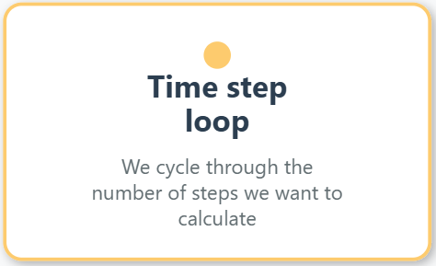
Workflow

Slide 14
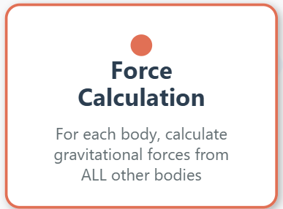
Workflow

Slide 15
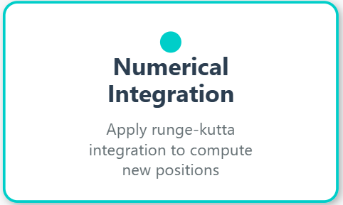
Workflow

Slide 16

Workflow

Slide 17
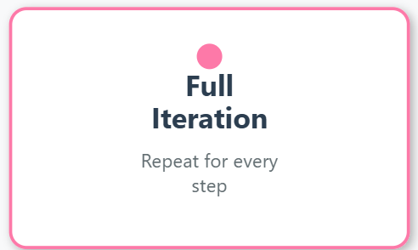
Workflow

Slide 18
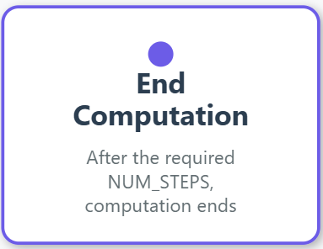
Workflow

Slide 19
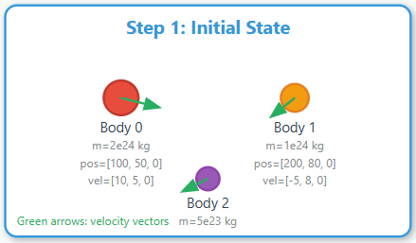
Example

Slide 20
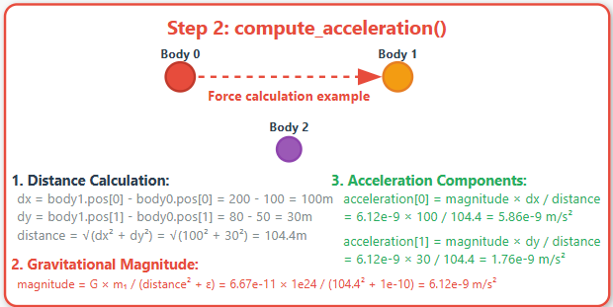
Example

Slide 21
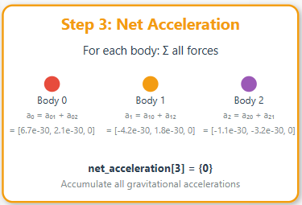
Example

Slide 22
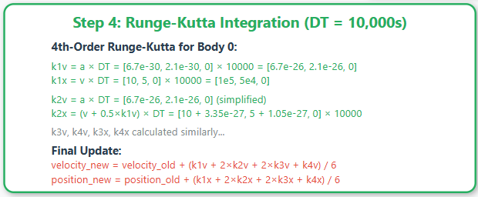
Example

Slide 23
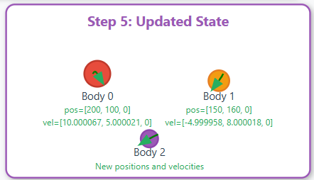
Example

Slide 24
04
Parallel implementation with MPI

Slide 25
In parallel environment
Bodies are partitioned across processors
Notes:
MPI (Message Passing Interface) è uno standard che definisce una libreria per la comunicazione tra processi su sistemi paralleli o distribuiti. Permette di inviare e ricevere dati tra diversi processi, semplificando lo sviluppo di programmi a calcolo parallelo.

Slide 26
In parallel environment
Bodies are partitioned across processors
Each process handles local_count bodies where local_count = NUM_BODIES / num_processes + remainder
Notes:
MPI (Message Passing Interface) è uno standard che definisce una libreria per la comunicazione tra processi su sistemi paralleli o distribuiti. Permette di inviare e ricevere dati tra diversi processi, semplificando lo sviluppo di programmi a calcolo parallelo.

Slide 27
In parallel environment
Bodies are partitioned across processors
Each process handles local_count bodies where local_count = NUM_BODIES / num_processes + remainder
Use of MPI custom datatype for communication (MPI_Bcast, MPI_Scatterv, MPI_Gatherv)
Notes:
MPI (Message Passing Interface) è uno standard che definisce una libreria per la comunicazione tra processi su sistemi paralleli o distribuiti. Permette di inviare e ricevere dati tra diversi processi, semplificando lo sviluppo di programmi a calcolo parallelo.

Slide 28
In parallel environment
Bodies are partitioned across processors
Each process handles local_count bodies where local_count = NUM_BODIES / num_processes + remainder
Use of MPI custom datatype for communication (MPI_Bcast, MPI_Scatterv, MPI_Gatherv)
Each processor computes local force calculations and update positions. Final state obtained via gathering all updated bodies to master process.
Notes:
MPI (Message Passing Interface) è uno standard che definisce una libreria per la comunicazione tra processi su sistemi paralleli o distribuiti. Permette di inviare e ricevere dati tra diversi processi, semplificando lo sviluppo di programmi a calcolo parallelo.

Slide 29
In parallel environment
Bodies are partitioned across processors
Each process handles local_count bodies where local_count = NUM_BODIES / num_processes + remainder
Use of MPI custom datatype for communication (MPI_Bcast, MPI_Scatterv, MPI_Gatherv)
Each processor computes local force calculations and update positions. Final state obtained via gathering all updated bodies to master process.
Global data dependency: every process needs all body positions for accurate force calculations
Notes:
MPI (Message Passing Interface) è uno standard che definisce una libreria per la comunicazione tra processi su sistemi paralleli o distribuiti. Permette di inviare e ricevere dati tra diversi processi, semplificando lo sviluppo di programmi a calcolo parallelo.

Slide 30
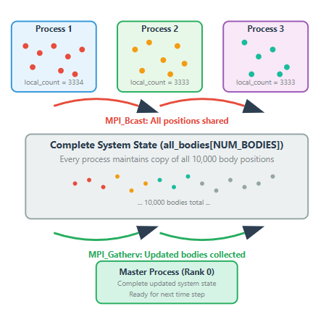
In parallel environment
Bodies are partitioned across processors
Each process handles local_count bodies where local_count = NUM_BODIES / num_processes + remainder
Use of MPI custom datatype for communication (MPI_Bcast, MPI_Scatterv, MPI_Gatherv)
Each processor computes local force calculations and update positions. Final state obtained via gathering all updated bodies to master process.
Global data dependency: every process needs all body positions for accurate force calculations
Notes:
MPI (Message Passing Interface) è uno standard che definisce una libreria per la comunicazione tra processi su sistemi paralleli o distribuiti. Permette di inviare e ricevere dati tra diversi processi, semplificando lo sviluppo di programmi a calcolo parallelo.

Slide 31
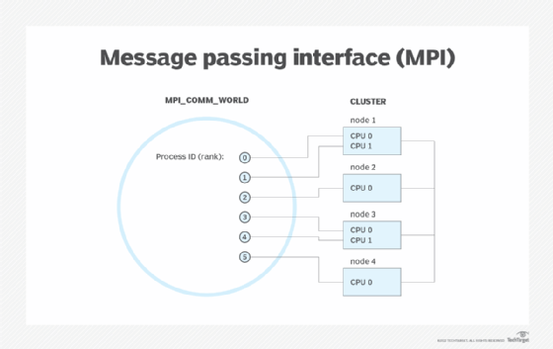
MPI Foundamentals
MPI Library:
Standard for distributed-memory parallelism
Provides process startup (MPI_Init) and shutdown (MPI_Finalize)
.Create specific MPI_Struct for 3D point and commit
Defines communicators, gathering, distribution of point
Provides MPI_Reduce for calculate time of execution.

Slide 32
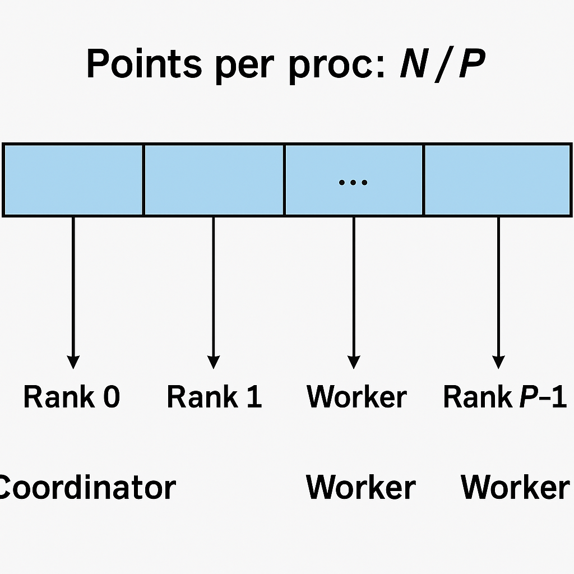
Processors Classification
In MPI, processor roles are assigned by the programmer via their ranks. We use rank 0 as the Coordinator and worker and ranks 1 to P−1 for the Workers.
Worker process: performs force calculations and numerical integration for assigned bodies in parallel. Each worker computes gravitational accelerations from ALL other bodies for its local subset of bodies, then updates positions and velocities using Runge-Kutta integration. All processes except the master fall into this category.
Coordinator process: in addition to Worker tasks, it manages coordination: broadcasting complete system state to all processes, scattering work assignments, gathering updated body states, assembling the complete updated system, and handling I/O (e.g., performance measurement, baseline time storage, and result output).

Slide 33
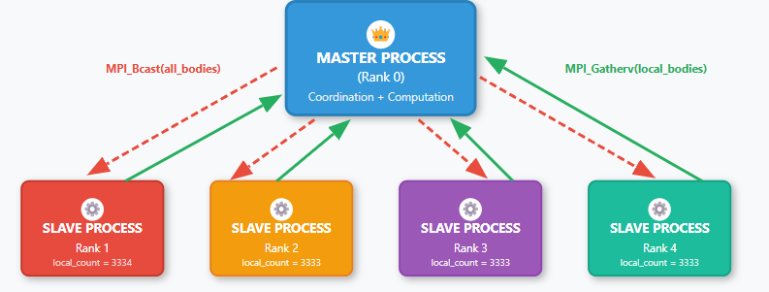
Master-Slave architecture
Master process responsabilities
System Initialization
Communication Coordination
I/O and Performance
Notes:
System Initialization: Initialize_random_bodies(), load balancing calculation
Communication Coordination: MPI_Bcast(), MPI_Scatterv(), MPI_Gatherv() operations
I/O and Performance: File operations, timing, speedup/efficiency calculations

Slide 34
Master-Slave architecture
Slave process responsabilities
Force Calculations
Numerical Integration
Parallel Execution
Notes:
Force Calculations: compute_acceleration() for assigned local bodies
Numerical Integration: runge_kutta_step() to update positions and velocities
Parallel Execution: Execute identical code on different data subsets (SPMD)

Slide 35
Master-Slave architecture
Why master-slave?
Global Data Dependency Management
Centralized I/O Control
Load Balancing
Synchronization Simplicity
Single Source of Truth
Notes:
Global Data Dependency management: Master ensures all processes have consistent global state (all_bodies array)
Centralized I/O Control: Prevents race conditions, single point for file operations
Load Balancing: Master calculates optimal work distribution
Synchronization Simplicity: Clear coordination through collective MPI operations (broadcast/gather)
Single Source of Truth: Master maintains authoritative system state, preventing inconsistencies

Slide 36
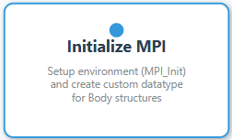
Workflow

Slide 37
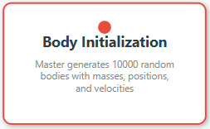
Workflow

Slide 38

Workflow

Slide 39
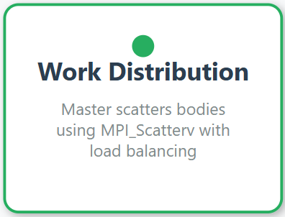
Workflow

Slide 40
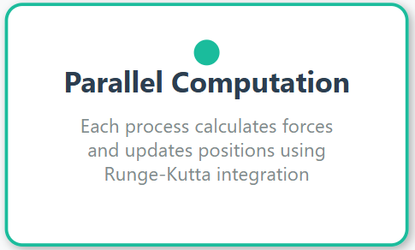
Workflow

Slide 41
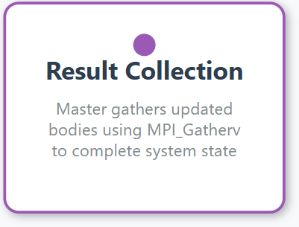
Workflow

Slide 42
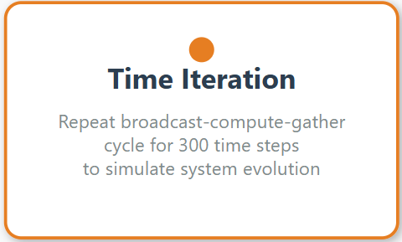
Workflow

Slide 43
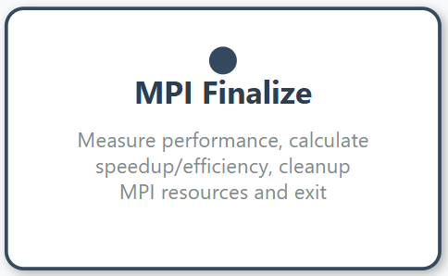
Workflow

Slide 44
05
Performance Evaluation

Slide 45
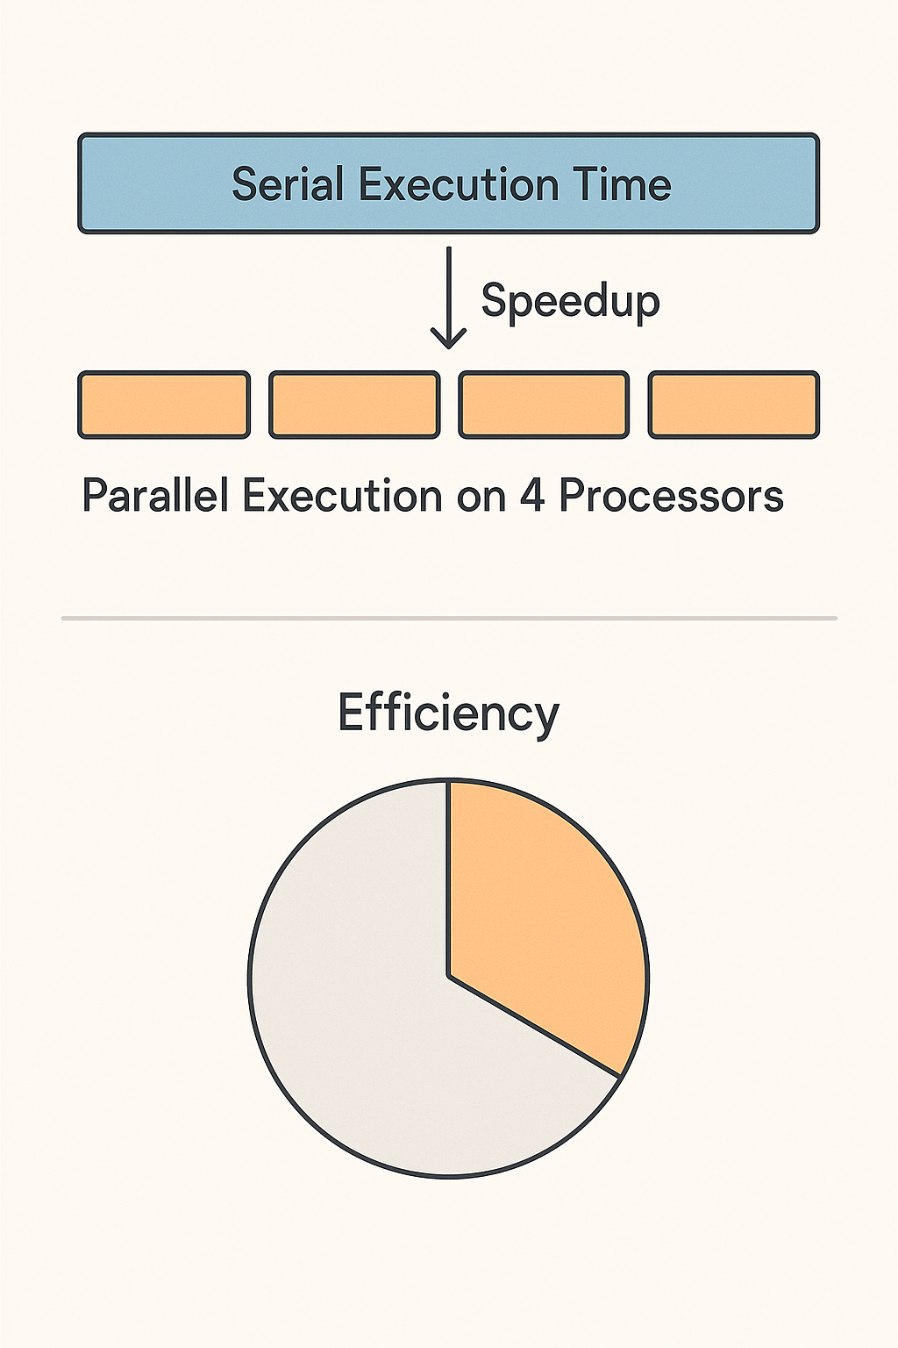
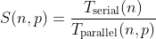
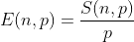
Speedup & Efficiency
Speedup → Measures how much faster a task runs with p processors compared to a single processor
Efficiency → Indicates how effectively the processors are utilized

Slide 46
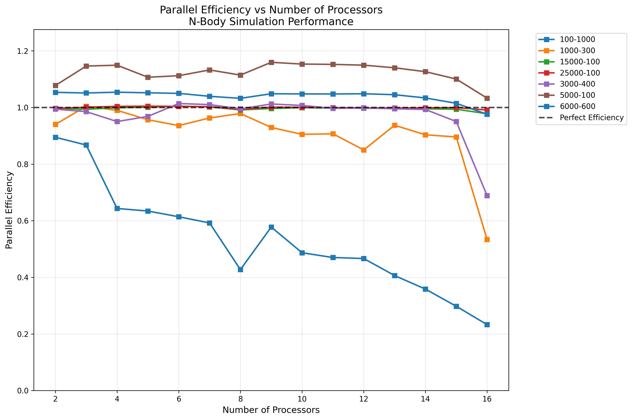

Slide 47
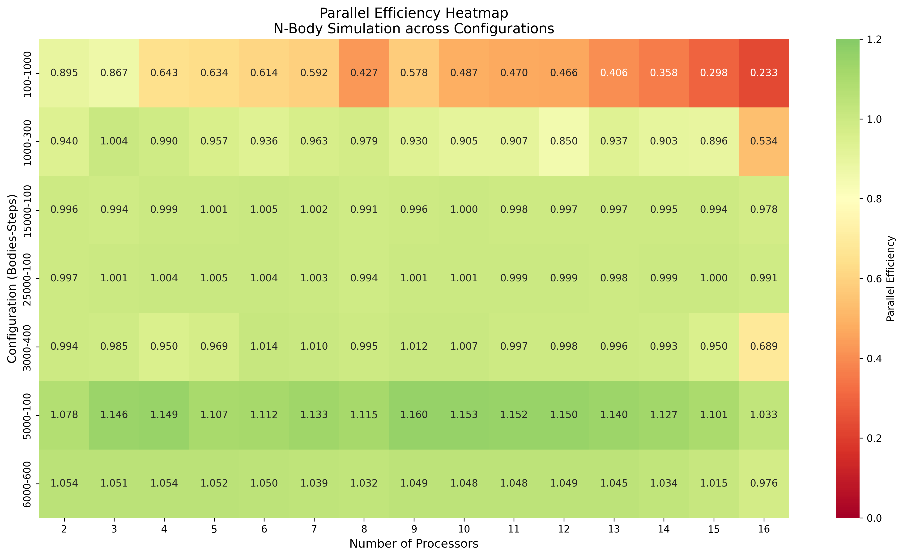

Slide 48
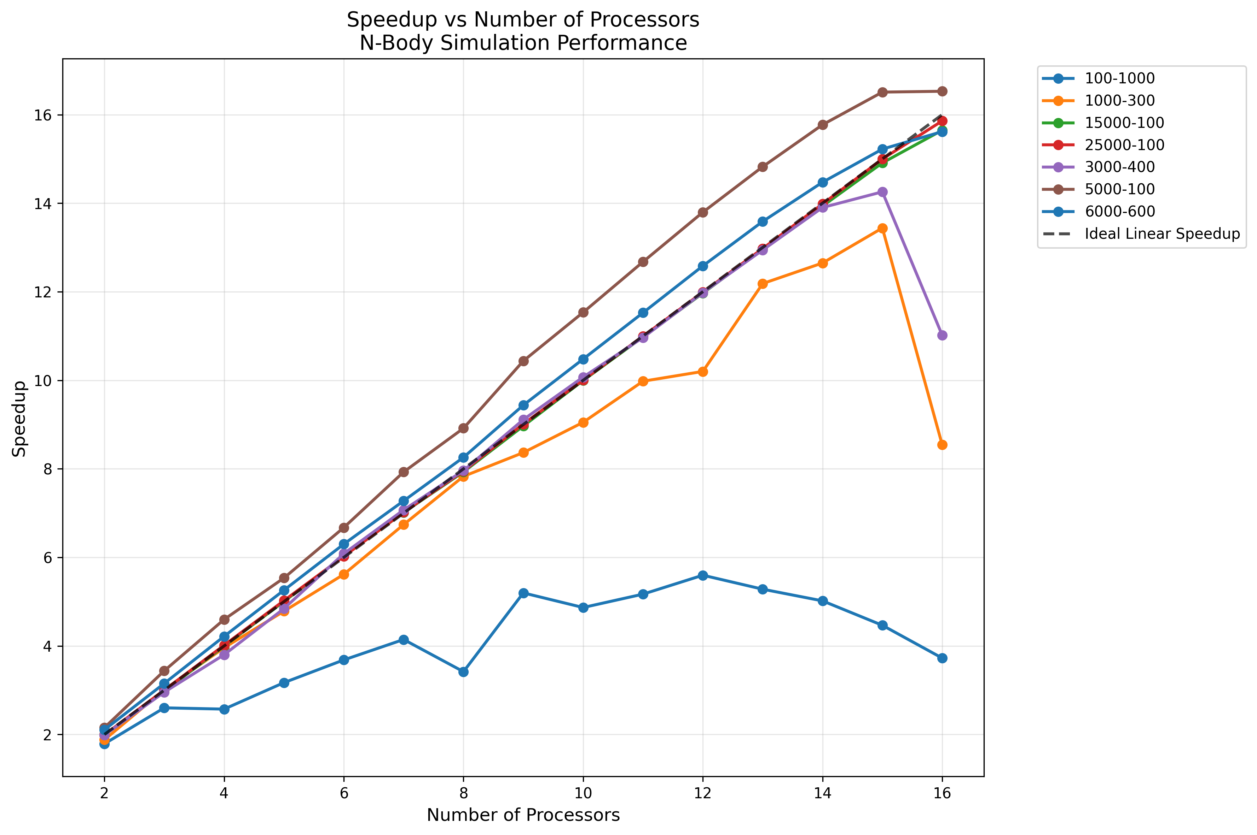

Slide 49
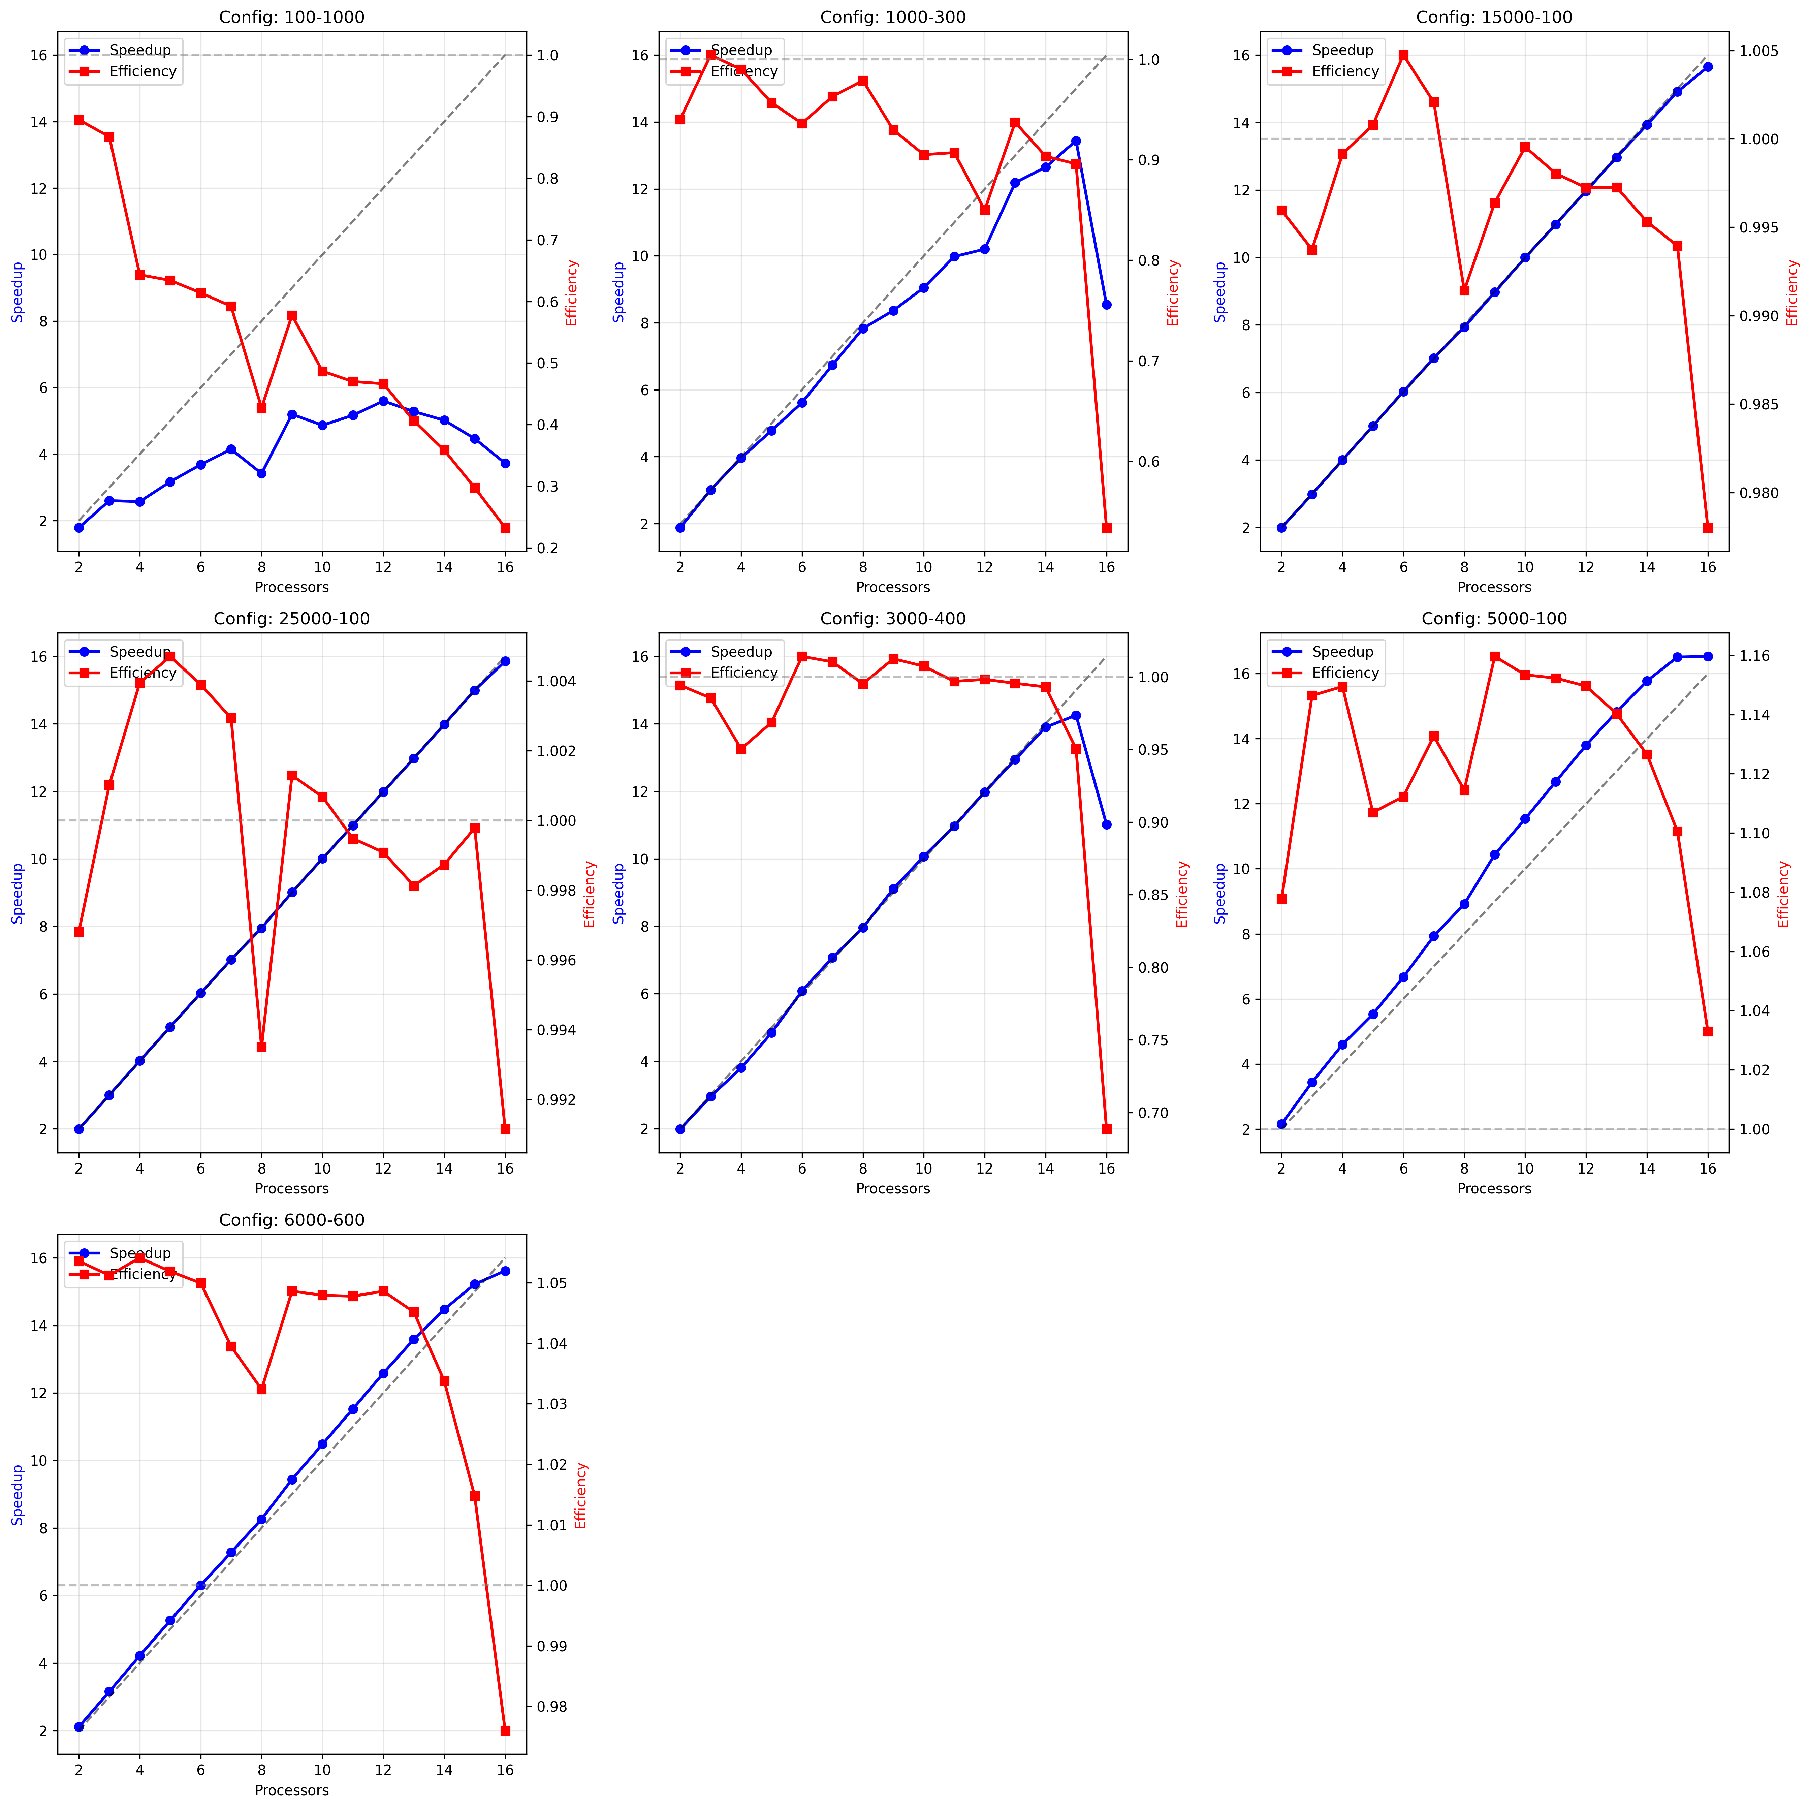

Slide 50
06
Conclusions

Slide 51
✅ Implemented and tested both sequential and parallel versions of the N-body gravitational simulation

Slide 52
✅ Implemented and tested both sequential and parallel versions of the N-body gravitational simulation
✅ The parallel version achieved lower execution time than the sequential one

Slide 53
✅ Implemented and tested both sequential and parallel versions of the N-body gravitational simulation
✅ The parallel version achieved lower execution time than the sequential one
✅ Parallel version → reduced execution time despite significant communication overhead due to global data dependency (every process needs all body positions)

Slide 54
✅ Implemented and tested both sequential and parallel versions of the N-body gravitational simulation
✅ The parallel version achieved lower execution time than the sequential one
✅ Parallel version → reduced execution time despite significant communication overhead due to global data dependency (every process needs all body positions)
⚠️ Results may vary due to execution on a shared multi-user system (Sibilla) and the communication-intensive nature of N-body simulations

Slide 55
✅ Implemented and tested both sequential and parallel versions of the N-body gravitational simulation
✅ The parallel version achieved lower execution time than the sequential one
✅ Parallel version → reduced execution time despite significant communication overhead due to global data dependency (every process needs all body positions)
⚠️ Results may vary due to execution on a shared multi-user system (Sibilla) and the communication-intensive nature of N-body simulations
⚠️ Performance scaling limited by O(N²) force calculations and broadcast communication pattern - efficiency degrades beyond 10-12 processors due to communication bottleneck

Slide 56
Thanks!
Do you have any questions?
Please keep this slide for attribution

